Slide 1
Data versus Information

Slide 2
Outline
Data and Information
Introducing the Database
Types of Database
Components of a Database
DBMS
Database Architecture

Slide 3
What is Data?
A collection for raw facts that can be in a structured or unstructured format.

Slide 4
Unstructured and Structured Data
Unstructured
Text Data (emails, posts, messages)
Audio Data (voice, music)
Video Data (surveillance, movies)
Image Data (medical images, satellite images)
Web Data (HTML documents)
Sensor Data (heart rate, weather patterns)
Structured
Tabular Data (spreadsheets)
Financial Data (transactions)

Slide 5
Data and Information
Usually, the terms “data” and “information” are used interchangeably.
However, there is a subtle difference between the two.

Slide 6
Difference Between Data and Information (Definition)
Data
Data is raw, unorganized, unstructured facts that need to be processed.
Data can be something simple and seemingly random and useless until it is organized.
Information
Information is when data is processed presented in a given context so as to make it useful.

Slide 7
Difference Between Data and Information (Decision Making)
Data
Raw data alone is insufficient for decision making
Information
Information is sufficient for decision making

Slide 8
Difference Between Data and Information (Real World Examples)
Data
Daily expenses on food and transportation for the year 2024.
Information
“On average, you are spending 100 pesos on food.”
“40% percent of your allowance goes to food.”
“You can save 50 pesos by walking instead of riding a tricycle”

Slide 9
My Daily Expenses Data
Date | Food | Transportation
2024-11-19 | 15 | 10
2024-11-20 | 20 | 12
2024-11-21 | 18 | 8
… | … | …

Slide 10
My Daily Expenses Data
Date | Food | Transportation
2024-11-19 | 15 | 10
2024-11-20 | 20 | 12
2024-11-21 | 18 | 8
… | … | …

Slide 11
My Daily Expenses Data
Date | Food | Transportation
2024-11-19 | 15 | 10
2024-11-20 | 20 | 12
2024-11-21 | 18 | 8
… | … | …

Slide 12
Outline
Difference between Data and Information
Introducing the Database
Types of Database
Components of a Database
DBMS
Database Architecture

Slide 13
What is a Database?
A database is a structured collection of data that is organized in a way to facilitate efficient storage, retrieval, and management of information.
It serves as a centralized and organized repository for storing and managing data, making it easier to access, update, and analyze information.

Slide 14

Real World Example
Let us also consider Facebook. It needs to store, manipulate, and present data related to members, their friends, member activities, messages, advertisements, and a lot more.
Their database are housed in a building called a data center

Slide 15
Types of Database
Databases can be classified into various types based on their structure, functionality, and purpose. Each type serves specific needs.
Some of the most popular types include:
Relational Database
Non-relational Database (NoSQL Database)
Cloud Databases

Slide 16
Relational Databases
Organizes data into tables (rows and columns) with predefined relationships between them.
Key Features
Uses SQL for querying.
Enforces data integrity through constraints (e.g., primary and foreign keys).

Slide 17




Relational Databases
Examples include:
MySQL
PostgreSQL
Oracle Database
Microsoft SQL Server

Slide 18
NoSQL Databases
Organizes data in different formats. It can handle unstructured or schema-less data.
Key Features
Can stores data as JSON, Key-Value pairs, Graphs
Scalable for large, distributed systems

Slide 19




NoSQL Databases
Examples include:
MongoDB
Redis
Cassandra
Neo4j

Slide 20
Cloud Databases
Databases are hosted and managed in the cloud.
Key Features
Scalability on-demand
Very large storage capacity but at a cost

Slide 21



Cloud Databases
Examples include:
Amazon AWS
Google Cloud Firestore
Microsoft Azure SQL Database

Slide 22
Outline
Difference between Data and Information
Introducing the Database
Types of Database
Components of a Database
DBMS
Database Architecture

Slide 23
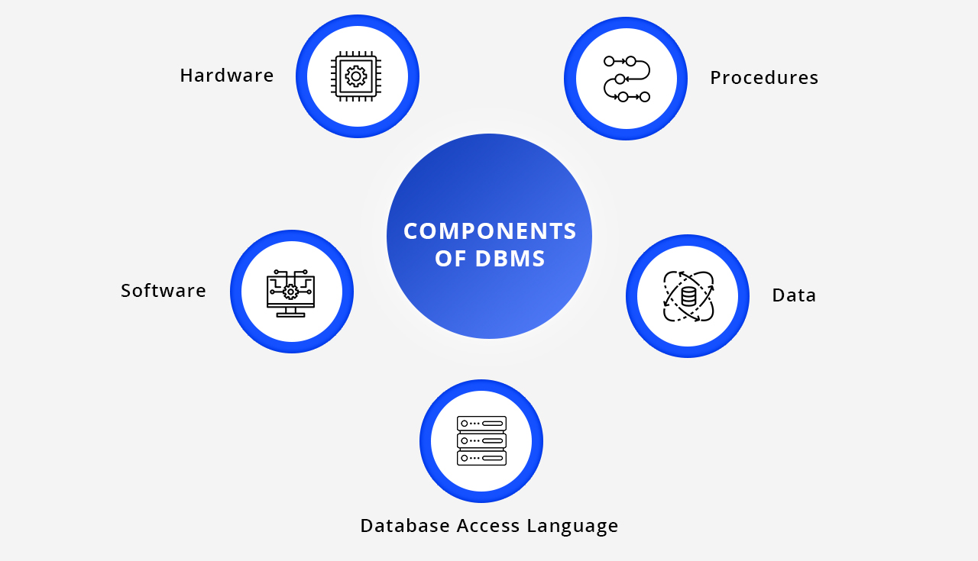
Five Components of a Database

Slide 24
Hardware
Hardware refers to the physical and electrical components, such as computers and hard drives, that provide the link between computers and actual systems

Slide 25
Software
This is a set of programs used to manage and control the overall database

Slide 26
Data
Any unprocessed fact stored in a database. The database is capable of storing any type of data, including structural, non-structural, and logical data.

Slide 27
Procedures
Procedures are the guidelines and commands that control the design and utilization of a database system

Slide 28
Database Access Language
Database Access language is used to access the data to and from the database, enter new data, update already existing data, or retrieve required data from the database

Slide 29
Outline
Difference between Data and Information
Introducing the Database
Types of Database
Components of a Database
DBMS
Database Architecture

Slide 30
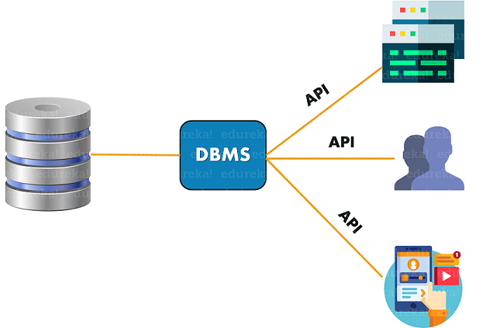
Database Management System
A database management system (DBMS) is a software application that enables users to quickly construct, design, and edit databases in order to store, process, and analyze data

Slide 31
Database Management System
A database management system (DBMS) provides an interface or a tool for doing various tasks, such as creating databases, putting data in them, updating data, creating database tables, and so on

Slide 32
Database Management System
Examples include:
MySQL
Oracle
SQL Server

Slide 33
Outline
Difference between Data and Information
Introducing the Database
Types of Database
Components of a Database
DBMS
Database Architecture

Slide 34
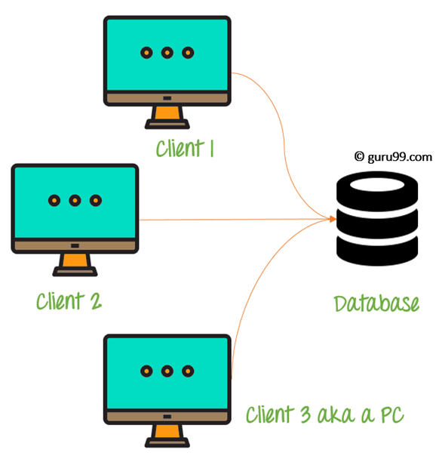
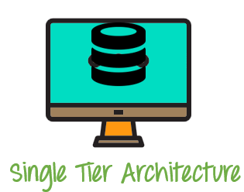
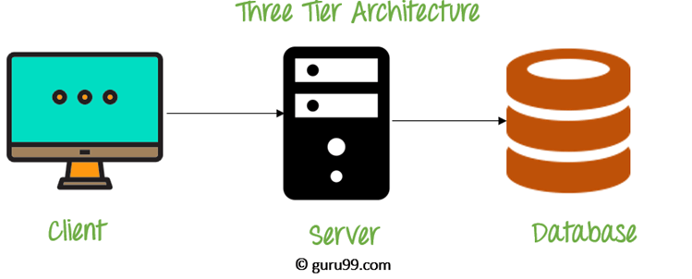
Types of DBMS Architecture
A DBMS architecture allows dividing the database system into individual components that can be independently modified, changed, replaced, and altered.

Slide 35
1-Tier Architecture
Tier Architecture is the simplest architecture of database in which the client, server, and database all reside on the same machine.
A simple one tier architecture example would be anytime you install a Database in your system and access it to practice SQL queries

Slide 36
2-Tier Architecture
A 2 Tier Architecture in DBMS is a Database architecture where the presentation layer runs on a client (PC, Mobile, Tablet, etc.), and data is stored on a server called the second tier.
Two tier architecture provides added security to the DBMS as it is not exposed to the end-user directly.

Slide 37
3-Tier Architecture
3-Tier architecture contains a presentation layer (your PC, phone, etc.), an application layer (server), and a database server.
The Application layer resides between the user and the DBMS, which is responsible for communicating the user’s request to the DBMS system and send the response from the DBMS to the user.

Slide 38
References
https://www.guru99.com/dbms-architecture.html

